Slide 1
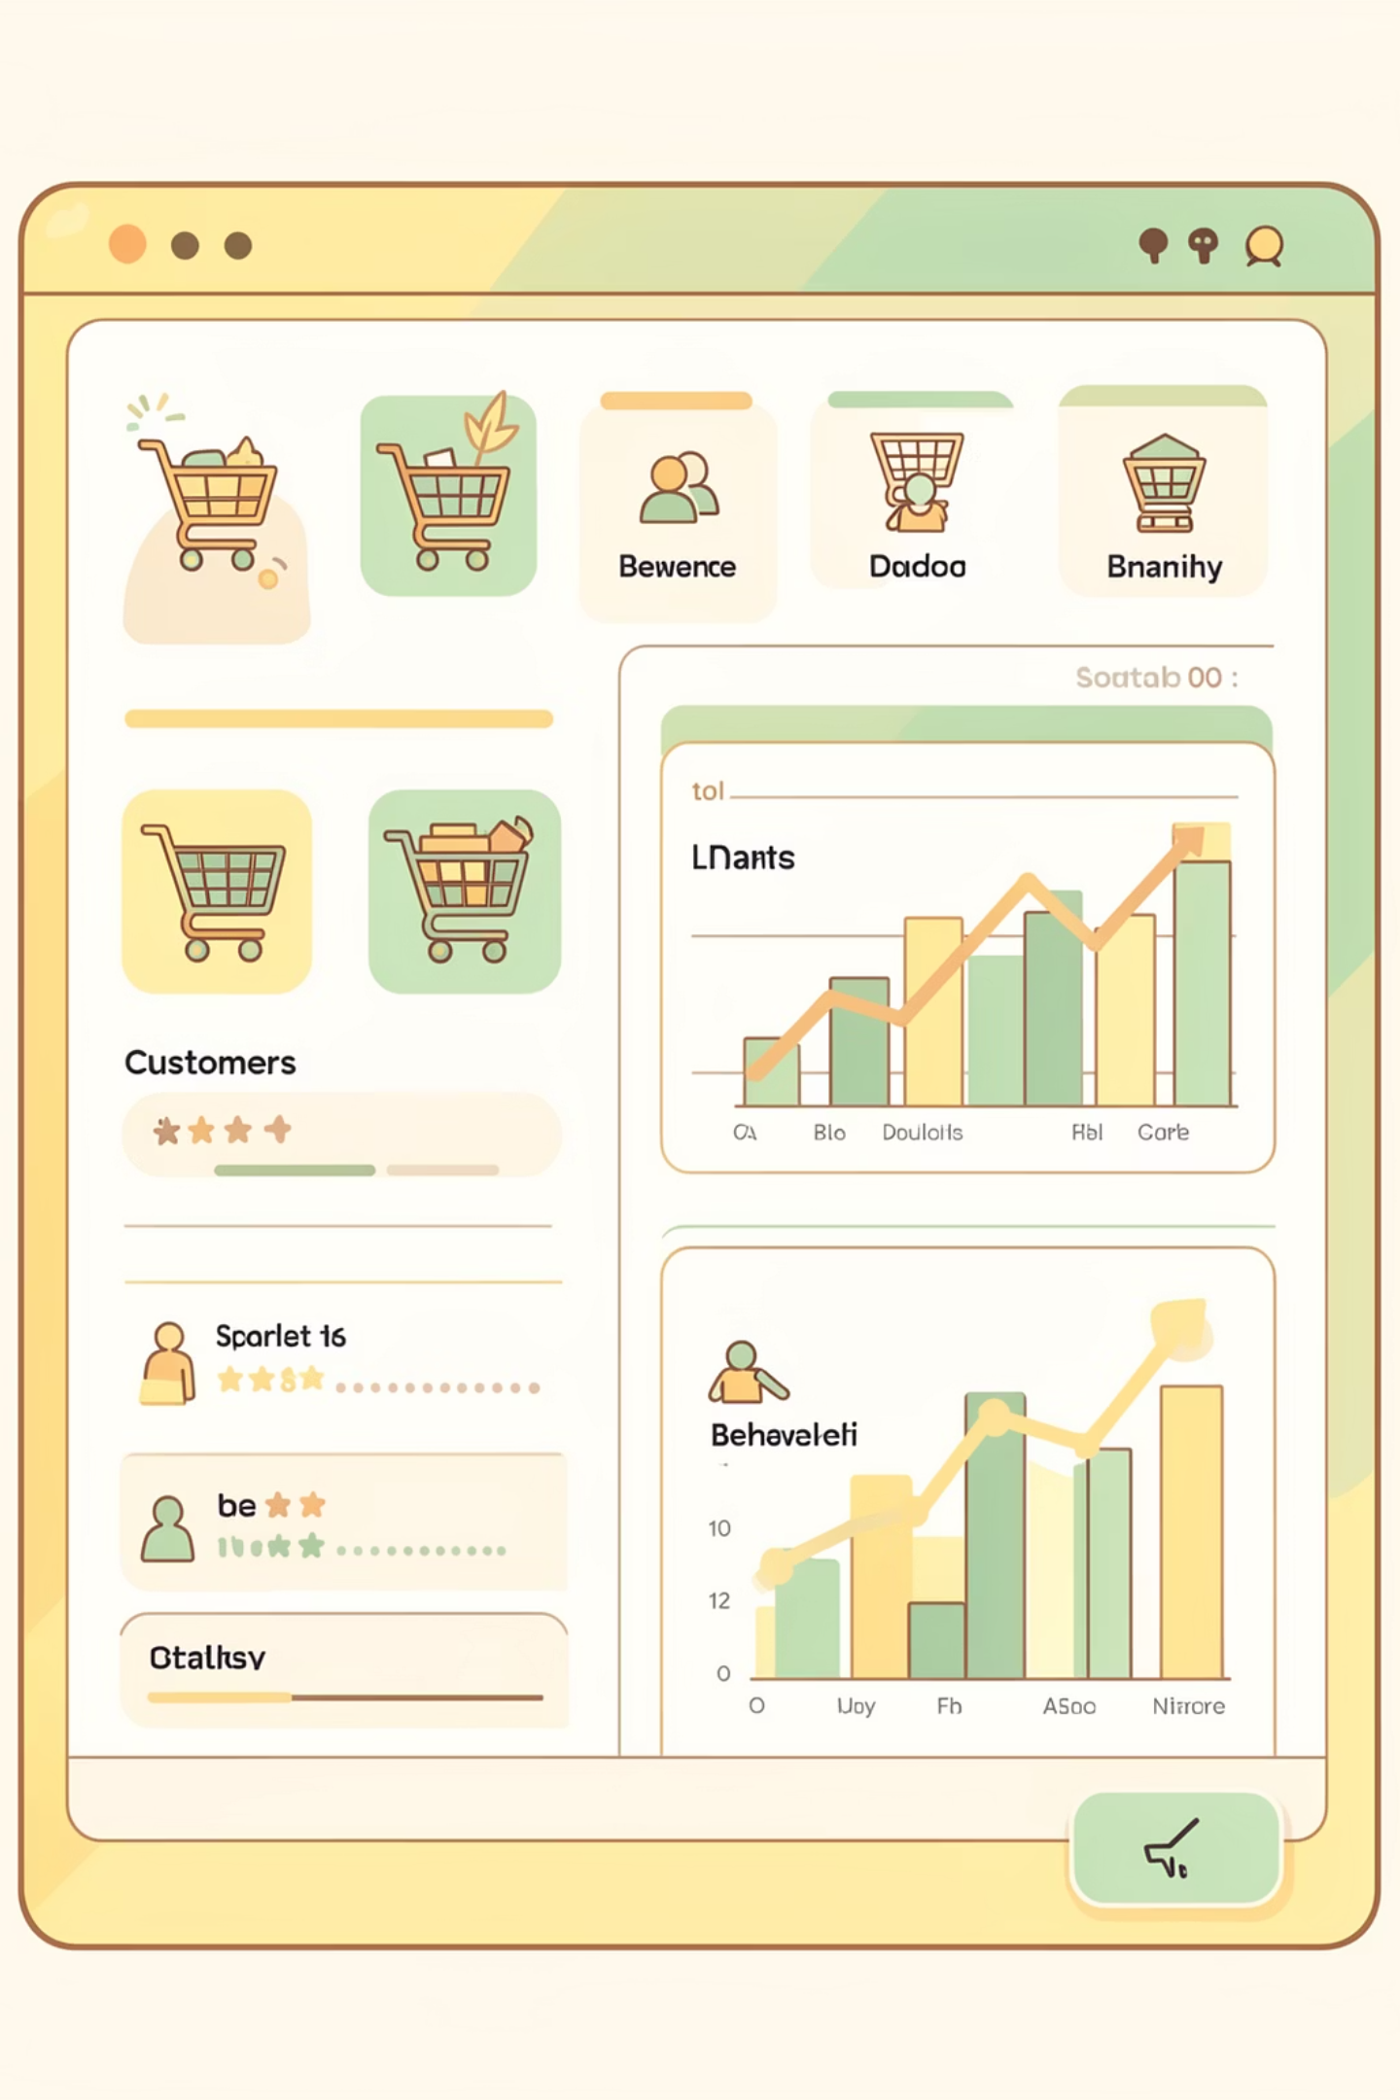
Customer Shopping Behavior Analysis
Uncovering insights from 3,900 purchases to guide strategic business decisions

Slide 2

DATASET OVERVIEW
The Foundation
3,900 Rows
18 Columns
37 Missing Values
Complete purchase records analyzed
Demographics, purchases, behavior metrics
Only in Review Rating column

Slide 3
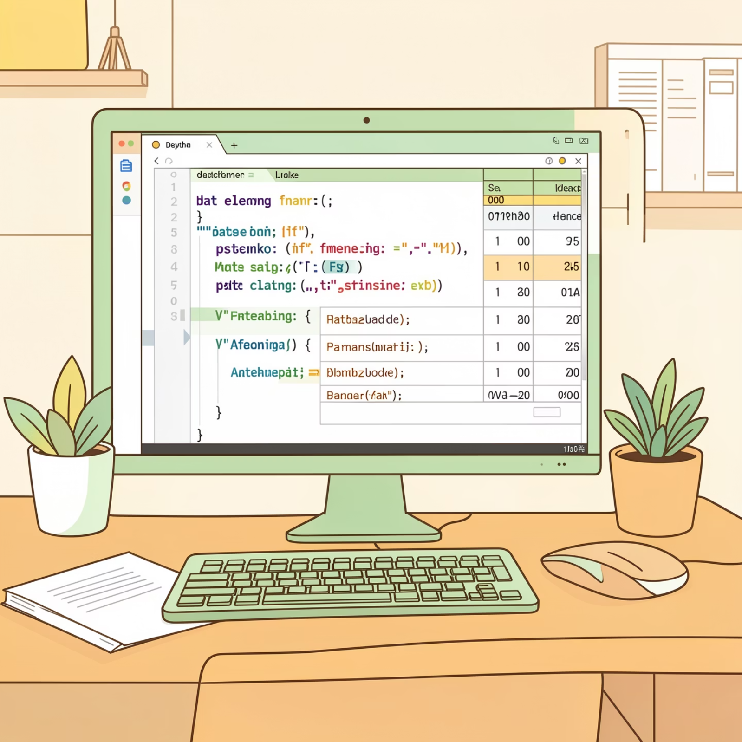
Data Preparation Journey
01
Data Loading & Exploration
Imported dataset, checked structure with pandas
02
Missing Data Handling
Imputed Review Ratings using median by category
03
Feature Engineering
Created age groups and purchase frequency metrics
04
Database Integration
Connected to PostgreSQL for SQL analysis

Slide 4

Key Customer Metrics
3.9K
$59.76
3.75
Total Customers
Average Purchase
Average Rating
Analyzed across all segments
Consistent spending pattern
Strong customer satisfaction

Slide 5
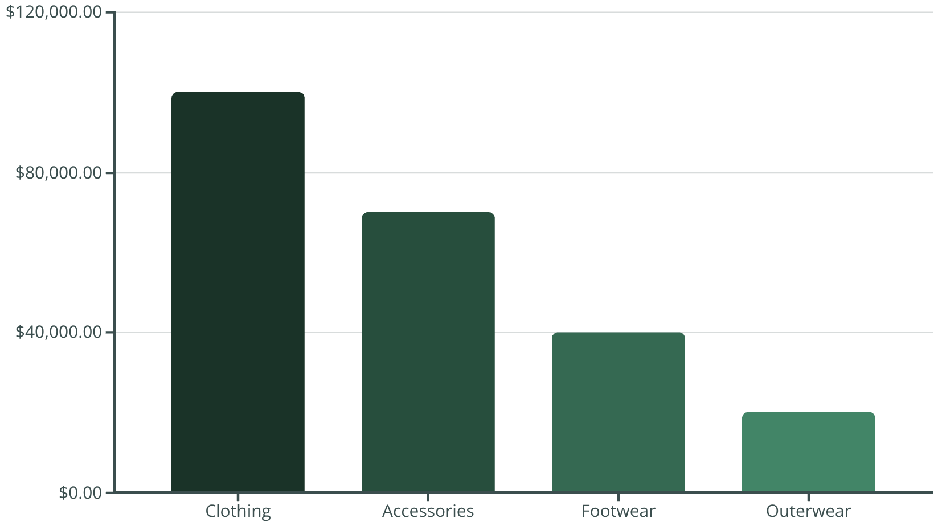
Revenue Insights
Category Performance
Clothing dominates revenue at $100K, followed by Accessories at $70K. Male customers generate 2x more revenue than female customers ($157,890 vs $75,191).
Top Product
Shipping Impact
Blouses lead with 171 purchases
Express shipping: $60.48 avg vs Standard: $58.46

Slide 6

Customer Segmentation
Loyal Customers
Returning
3,116 customers (80%)
701 customers (18%)
Repeat buyers with 5+ purchases
2-4 previous purchases
New Customers
83 customers (2%)
First-time buyers

Slide 7
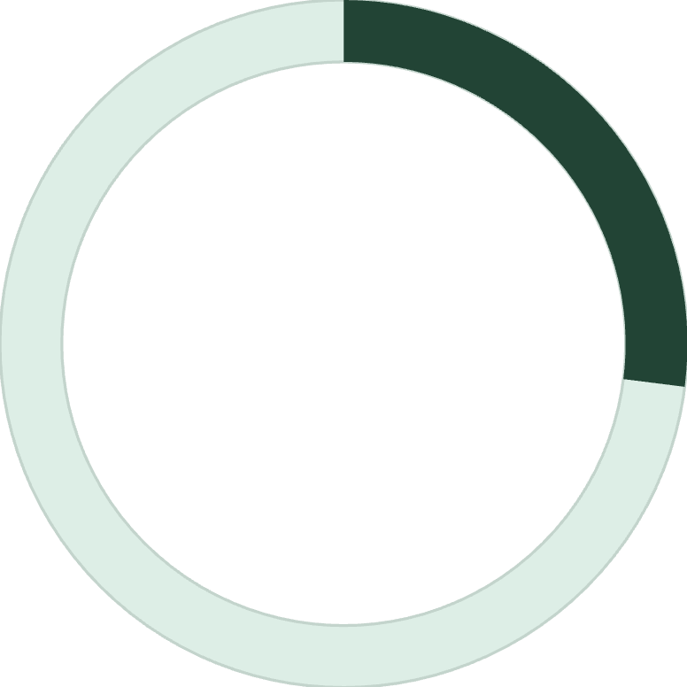
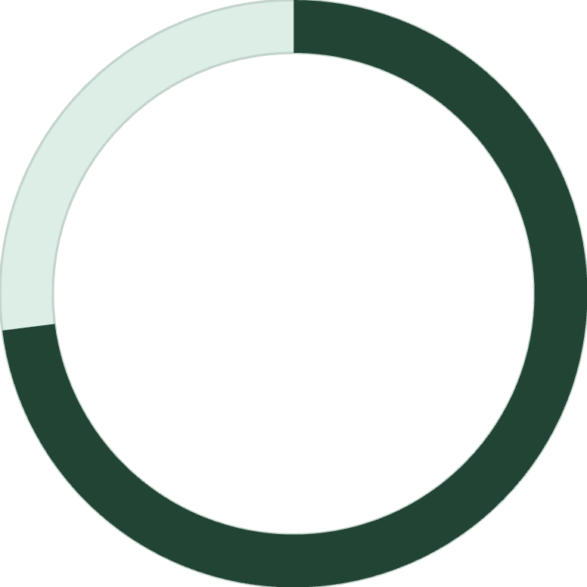
Subscription Analysis
27%
73%
Subscribed
Non-Subscribed
1,053 customers with subscriptions
2,847 customers without subscriptions
Spending Comparison
Repeat Buyer Insight
Subscribers: $59.49 average spend
Among customers with 5+ purchases: 958 are subscribers, 2,518 are not. Huge opportunity to convert loyal customers.
Non-subscribers: $59.87 average spend
Minimal difference suggests untapped potential

Slide 8


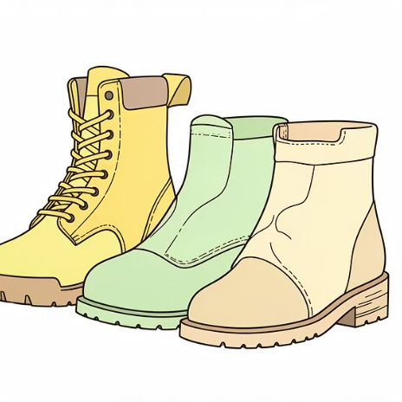

Top Performing Products
Gloves
Sandals
Boots
Hat
Highest rating: 3.86 stars
Second best: 3.84 stars
Strong performer: 3.82 stars
Top rated: 3.80 stars, 50% discount rate

Slide 9
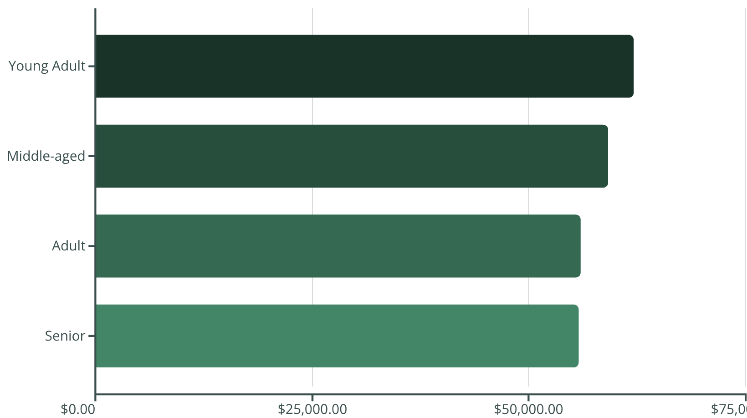

Age Group Revenue Distribution
Demographic Insights
Young Adults lead revenue generation at $62K, with relatively balanced contributions across all age groups.
Key Finding: 839 customers used discounts but still spent above average ($60+), indicating price sensitivity doesn't always mean low spending.

Slide 10
STRATEGIC RECOMMENDATIONS
Action Plan for Growth
Boost Subscriptions
1
Promote exclusive benefits to convert 2,518 loyal non-subscribers
Loyalty Programs
2
Reward repeat buyers to strengthen the 80% loyal customer base
Review Discount Policy
3
Balance sales boosts with margin control—50% discount rate on some products
Product Positioning
4
Highlight top-rated items (Gloves, Sandals, Boots) in marketing campaigns
Targeted Marketing
5
Focus on Young Adults and express-shipping users for maximum ROI

